Slide 1
PID Control
An Overview

Slide 2
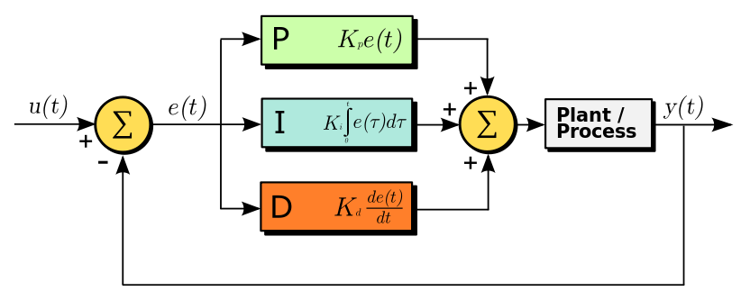
What is PID control?
PID is a form of automatic feedback control based on error
Error is the difference between the variable under control y(t) and a reference u(t)
P, I, D are mathematical operations applied to the error to generate the process actuating signal

Slide 3
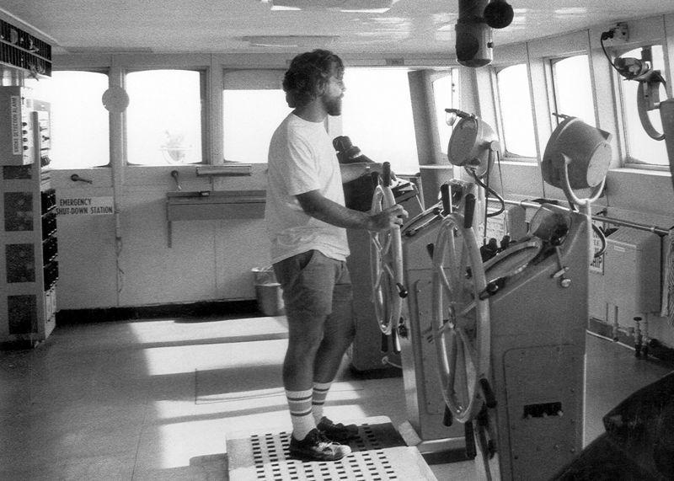
Where does PID come from?
James Watt’s flyball governor in 1788: P-only control
PID first used for governor control in 1890’s
Nicolas Minorsky researched automatic steering systems for US Navy ships in 1922
Observed steering actions of experienced helmsmen
Helmsmen controlled ship based not only on current error, but also past error and current rate of change
Formalised observations as mathematical equations
Successfully trialled aboard USS New Mexico, but ultimately not adopted due to “resistance by personnel”
3

Slide 4
Why is PID used so extensively?
The mathematical operations of multiplication, integration and differentiation have proved easy to implement with the technology of the day
Mechanical
Pneumatic
Electronic analog
Electronic digital
Very low computational overhead for large scale digital processor systems
Simple to configure and tune
Has proven to be robust and stable
Handles unmeasured disturbances well
Does not require a model
4

Slide 5
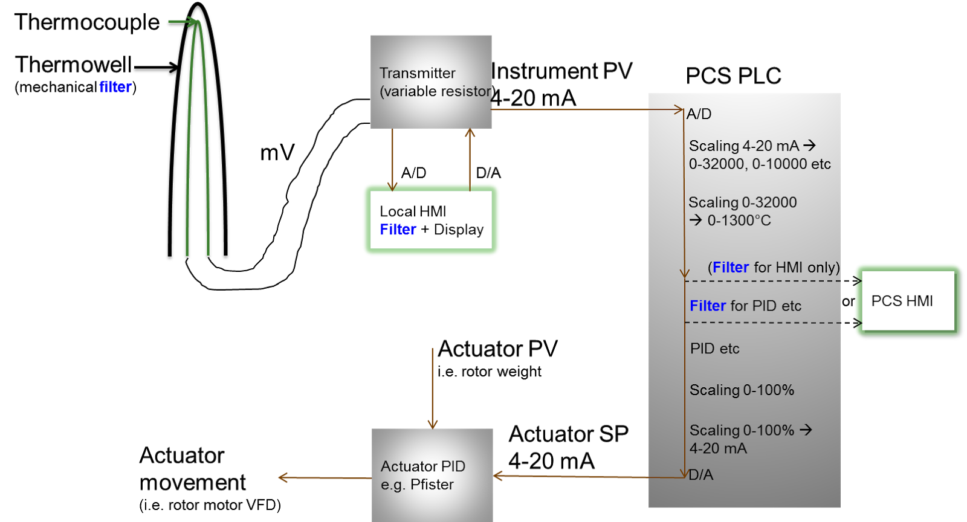
What is a typical PID implementation on a plant?
5

Slide 6
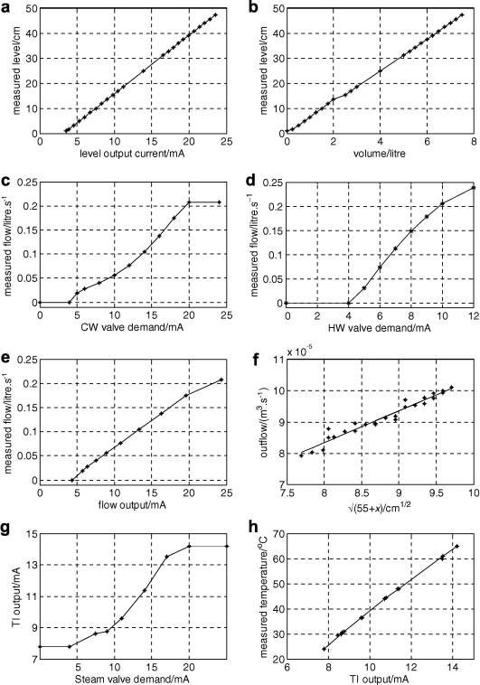
You can only control what you can measure
Instrument calibration
– neccessary!
6

Slide 7
PID configurable parameters: Decisions to make upfront
Or, thank goodness for automation engineers!
Direct vs Reverse control direction
Most control systems don’t take negative gains, so…
Should the controller output increase with increasing PV, or decrease?
Increase → Direct, e.g. Level-to-flow out
Decrease → Reverse, e.g. Flow control
7

Slide 8
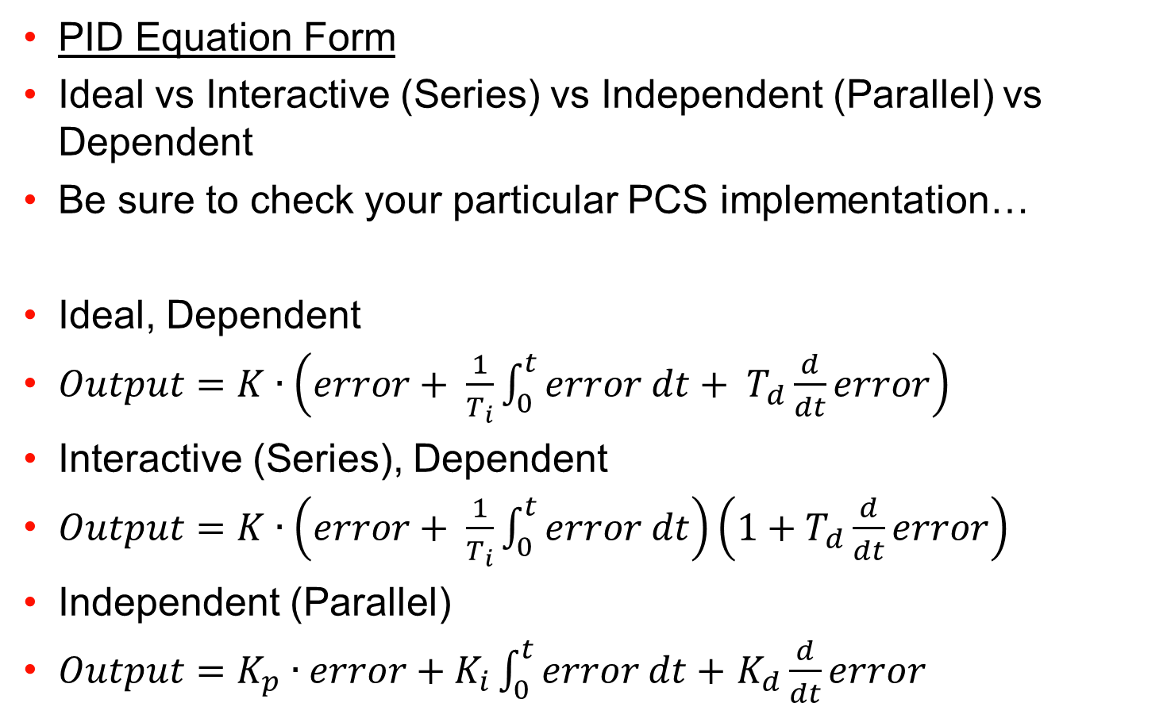
PID configurable parameters: Decisions to make upfront (2)
8

Slide 9
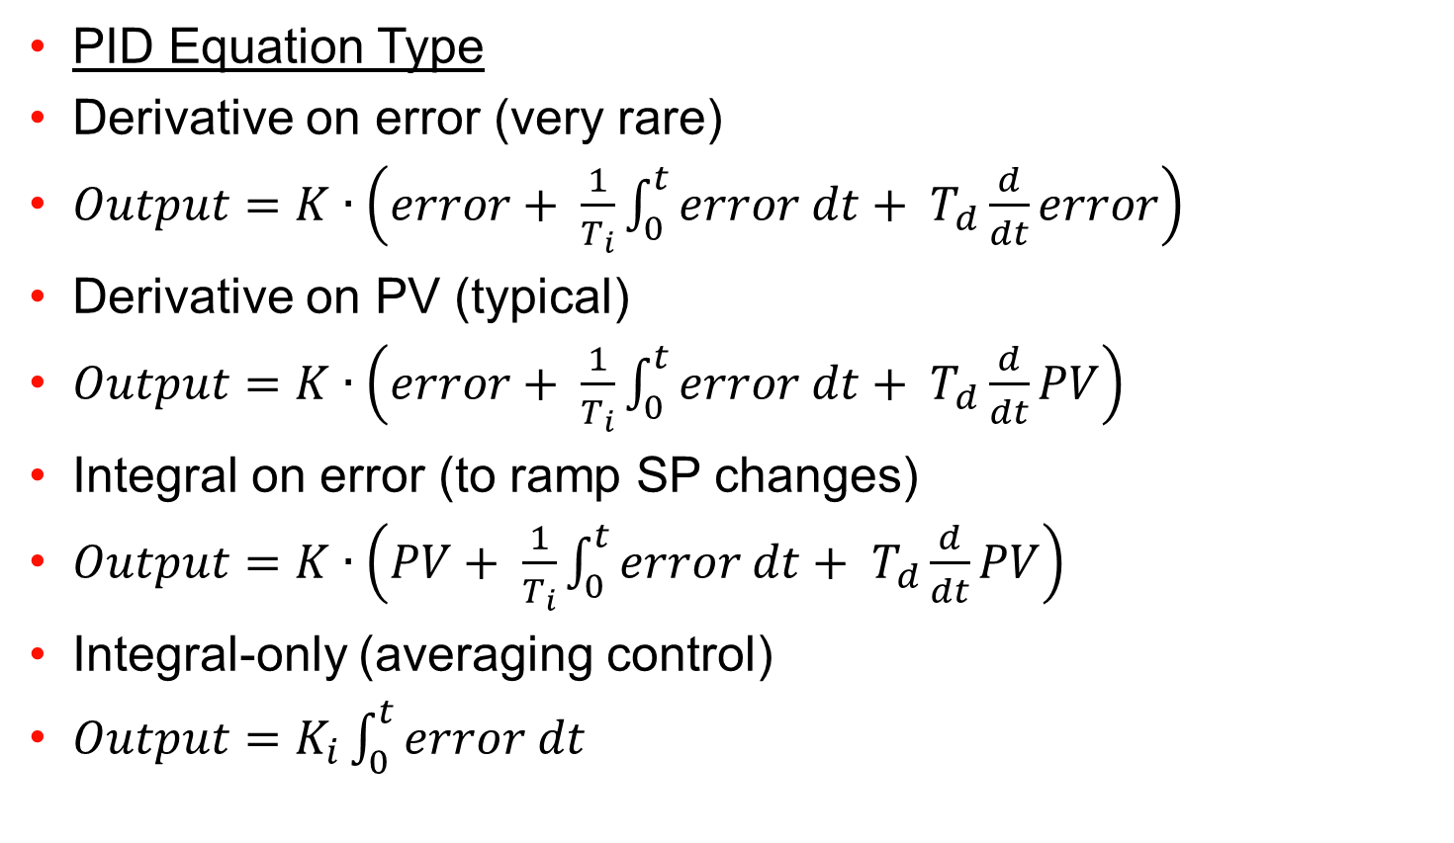
PID configurable parameters: Decisions to make upfront (3)
9

Slide 10
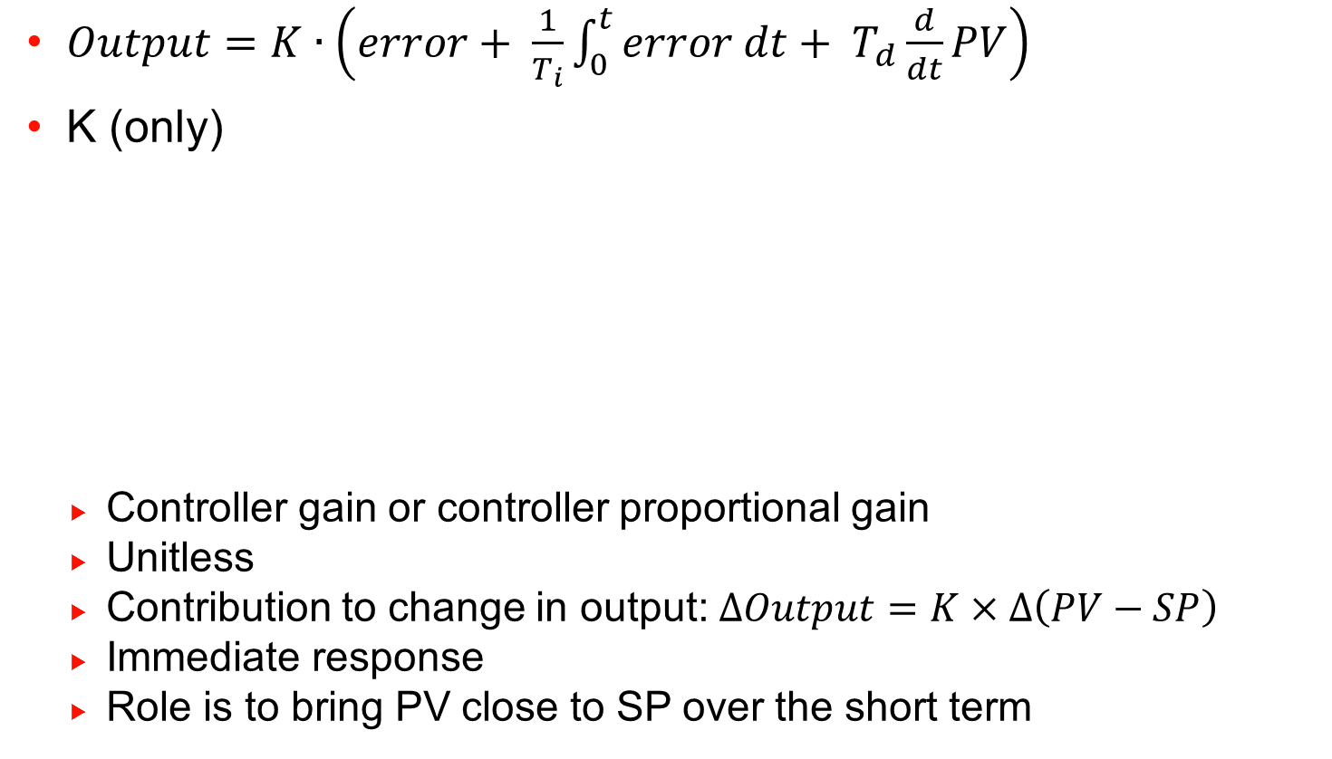
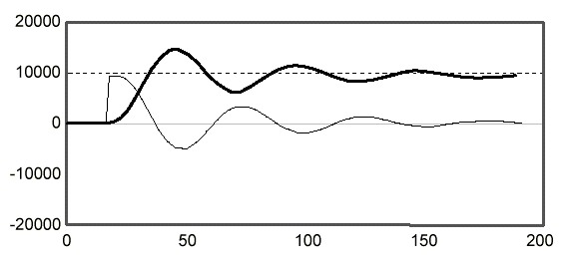
PID configurable parameters: Tuning
10

Slide 11
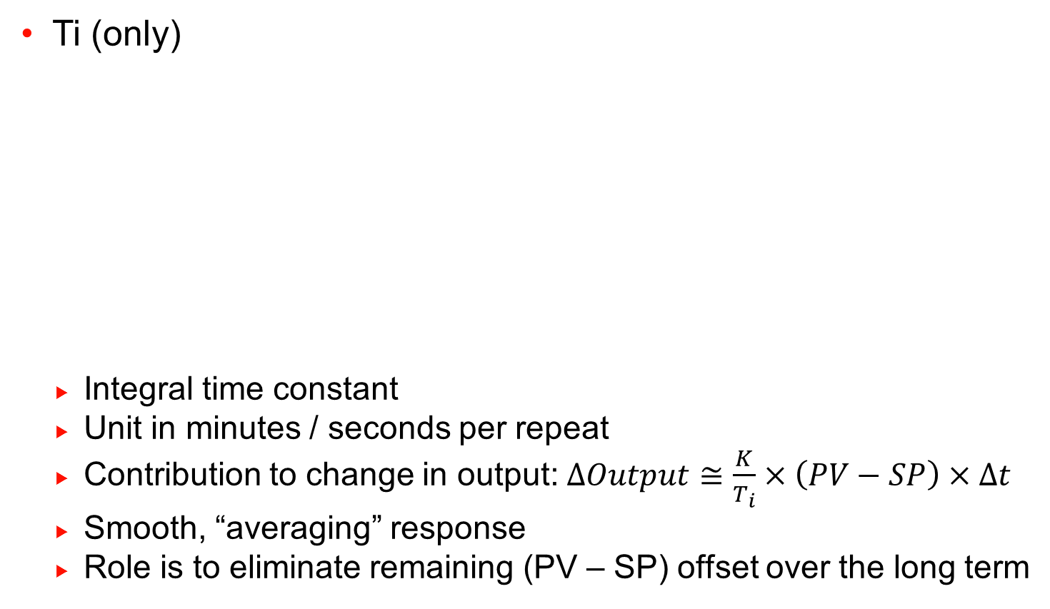
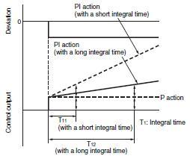
PID configurable parameters: Tuning (2)
11

Slide 12
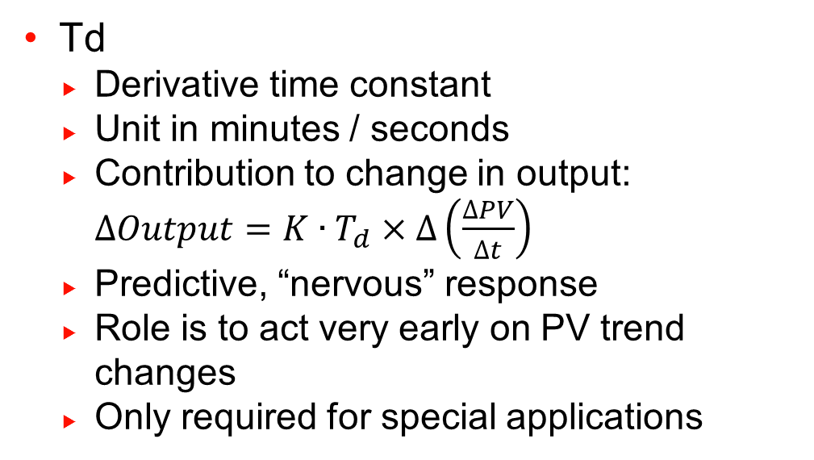
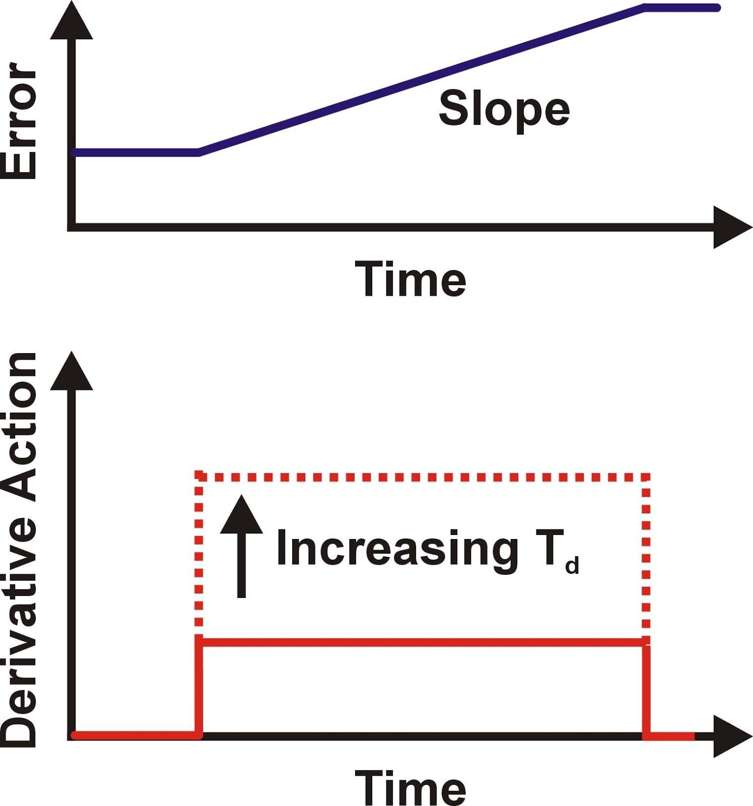
PID configurable parameters: Tuning (3)
TF
PV filter time constant
Unit in Minutes / seconds
Contribution to change in output: None
Role is to reduce PV signal “noise” so PID does not act on it
12

Slide 13
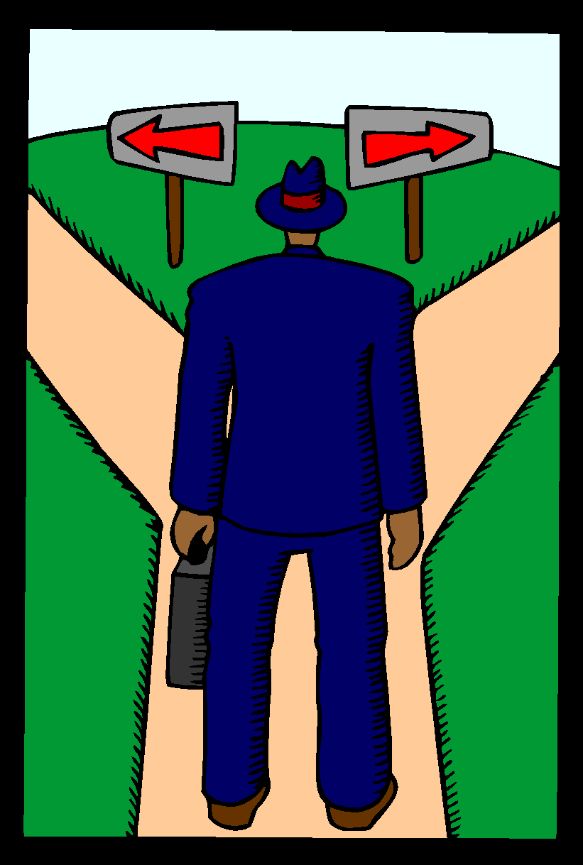
Tuning: Different approaches
13

Slide 14
Incremental tuning vs Control response design
Incremental tuning assumes a few things:
A valid starting point (NB!)
User experience
A good imagination
…and has some characteristics:
Not repeatable or systematic (art)
Evaluation dependent on process conditions
Control response design assumes a few things:
You may step change the process
Process responses are more or less consistent
Some mathematical ability, and a good imagination
…and has some characteristics:
Recipe-based and quantifiable (science)
Evaluation dependent on measuring objectives
14

Slide 15
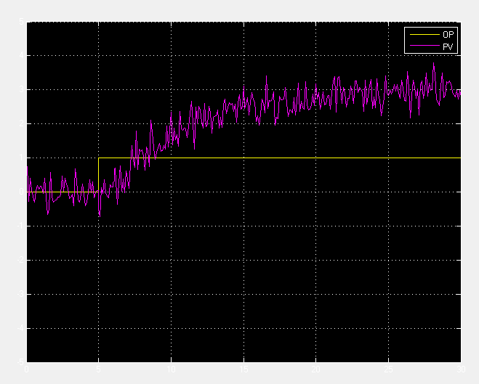
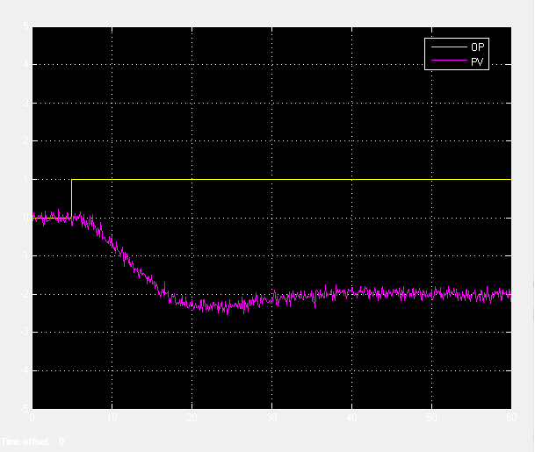
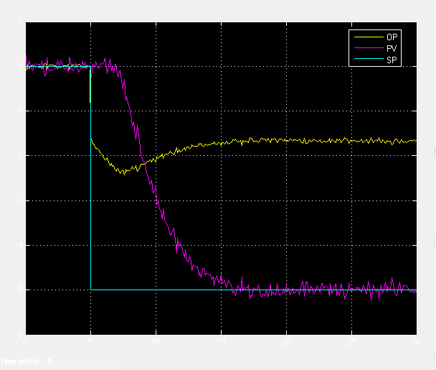
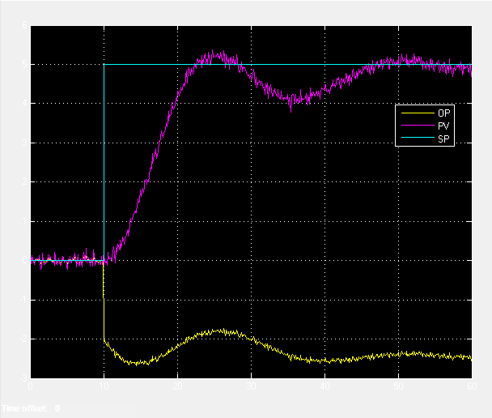
Open vs Closed loop responses
15

Slide 16
How do you characterize a response?
16

Slide 17
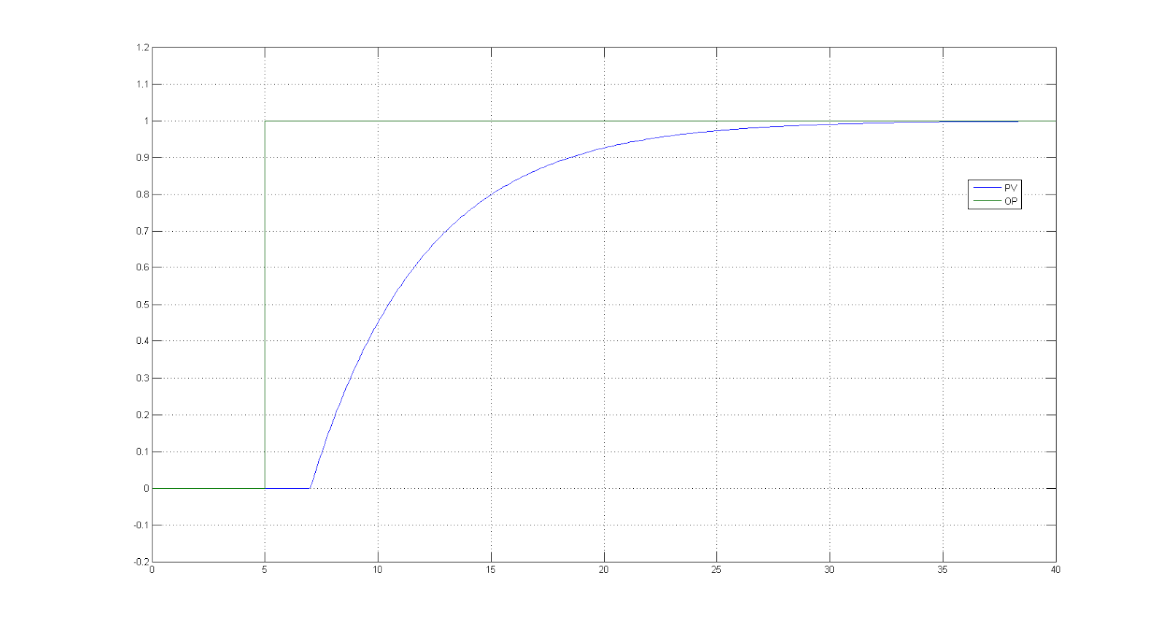
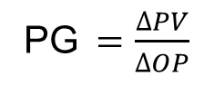
How do you characterize a response?
0.98
0.632
Time constant (τ (=Tau))
Time to Steady State (TTSS)
≈ 4×τ
Dead time (θ)
17

Slide 18
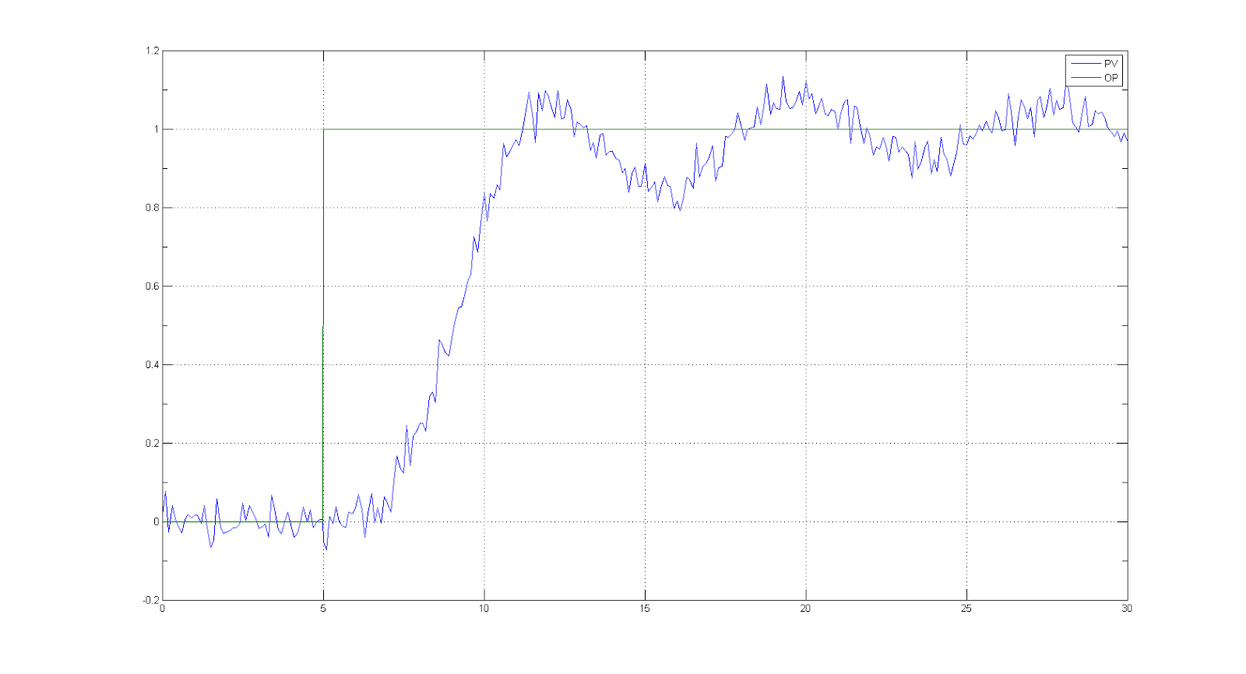
The real world
18

Slide 19
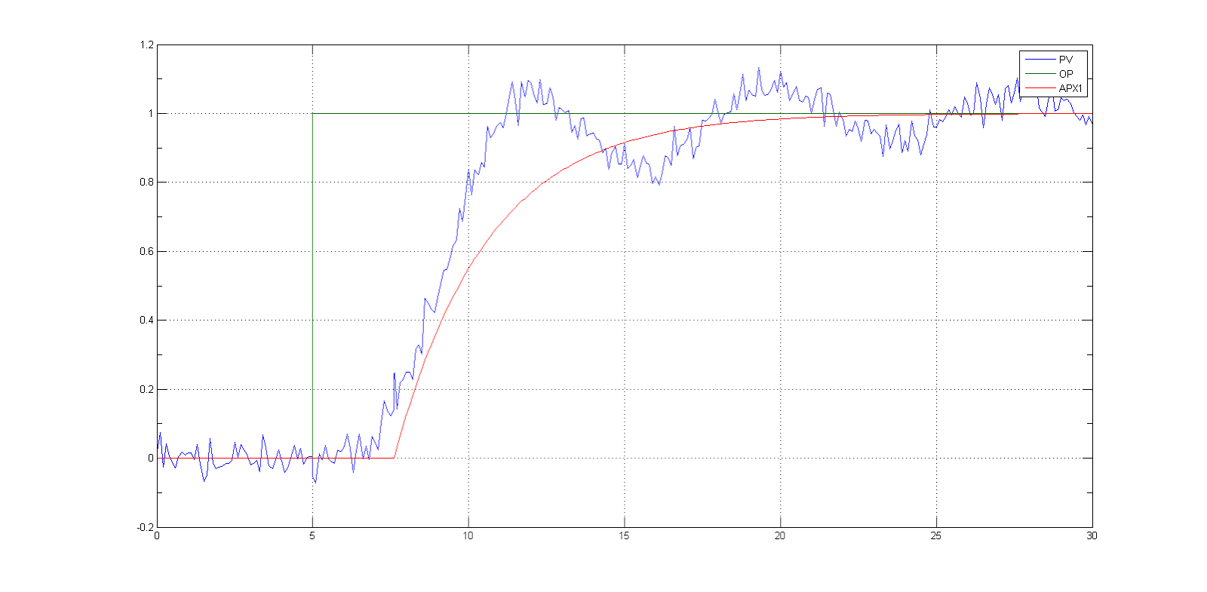
Approximation 1
Time constant (τ)
≈ 5.5 min
Dead time (θ)≈ 5 min
19

Slide 20
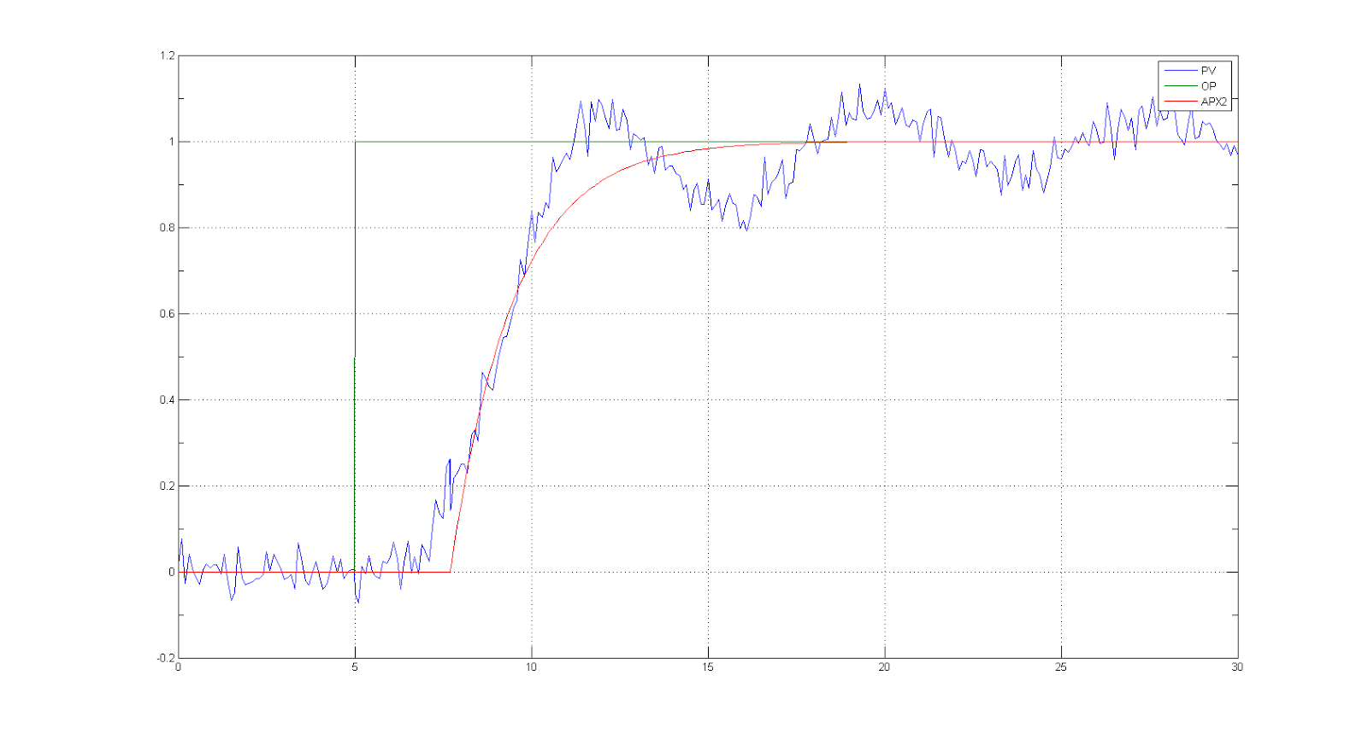
Approximation 2
0.632
Time constant (τ)
≈ 4.5 min
Dead time (θ)≈ 5 min
20

Slide 21
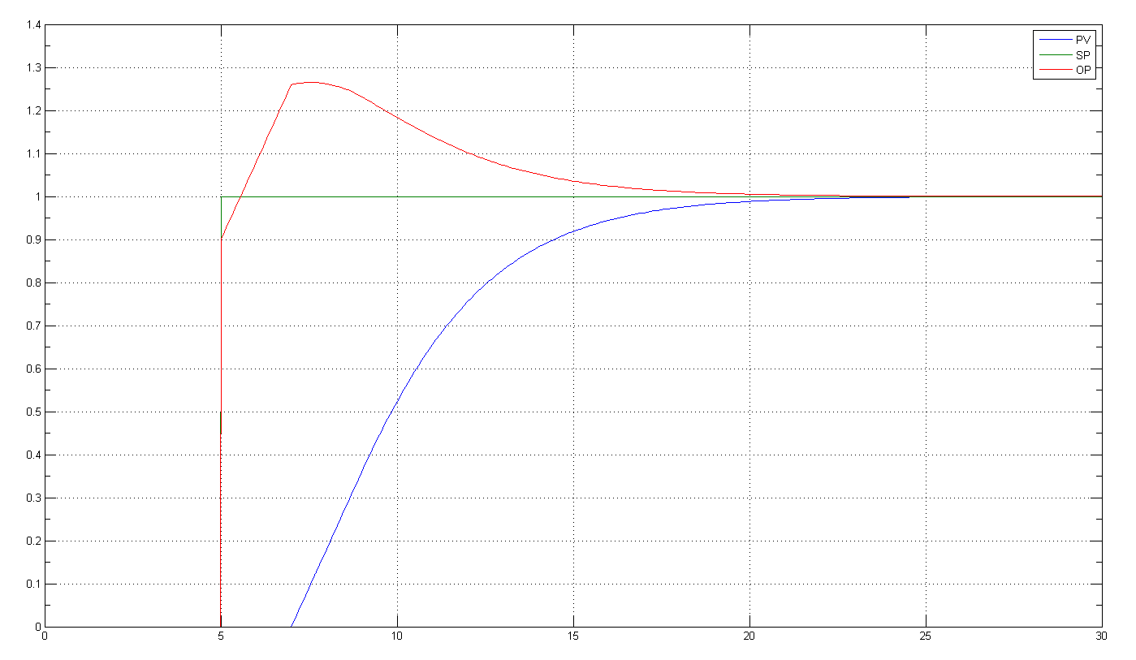
What is the objective of response design?
The main objective of response design is to get a desired control speed of response with minimum actuator travel
0.632
Closed loop time constant (λ)
21

Slide 22
What is important about the closed loop time constant λ?
λ sets the desired speed of response of the control loop
λ is always judged relative to the open loop time constant τ:
λ << τ – Tuned “fast / overshoot”
λ ≈ τ – Tuned “normal”
λ >> τ – Tuned “slow” / “buffering action”
22

Slide 23
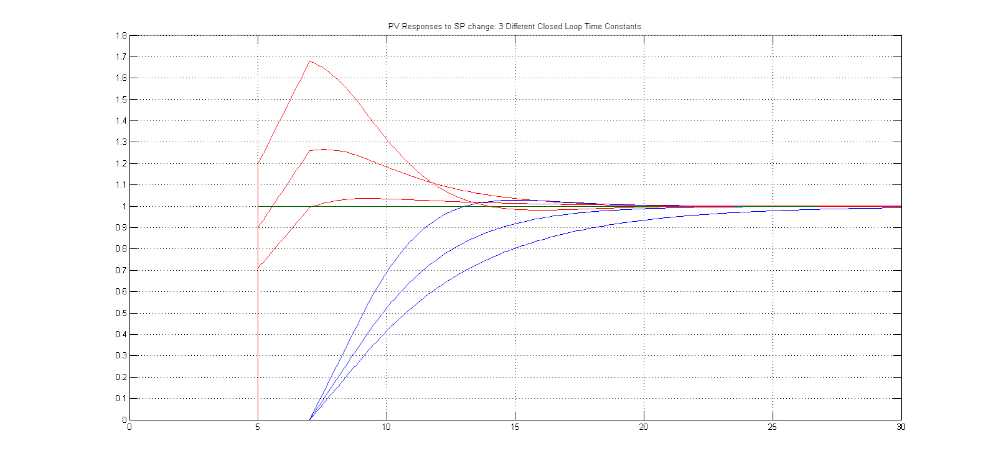
The effect of closed loop time constant: Setpoint change
2.7
3.7
5
0.632
2.7
3.7
5
23

Slide 24
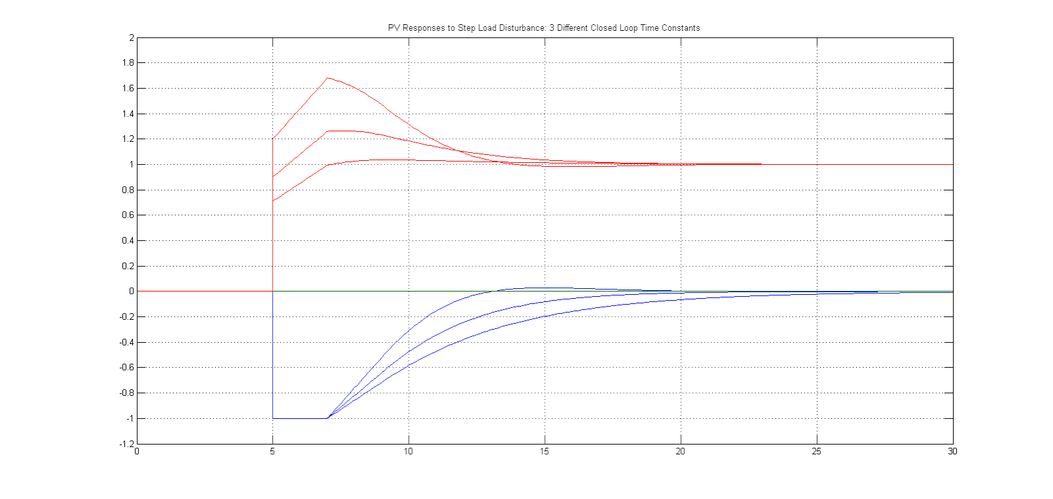
The effect of closed loop time constant: PV disturbance
2.7
3.7
5
2.7
3.7
5
TTSS ≈ 4×2.7=10.8
TTSS ≈ 4×3.7=14.8
TTSS ≈ 4×5=20.0
24

Slide 25
Control response design = Tuning rules?
There are many tuning rules
E.g. Ziegler-Nichols, Cohen-Coon, Internal Model Control
Usually the underlying basis: λ and damping, is pre-selected and hidden
IMC, Internal Model Control, is an approach to solve, for a given model, the tuning parameters which gives a critically damped closed loop response with time constant = λ
Also known as “Lambda” tuning
Opens up the design process so that speed of response can be specified by the user
25

Slide 26
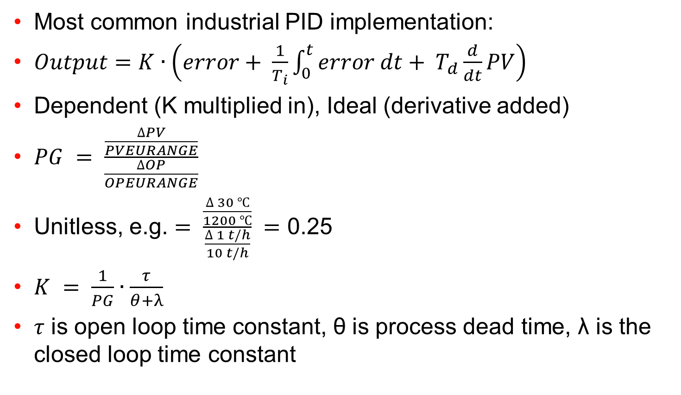
Proportional Action: How to calculate K
26

Slide 27
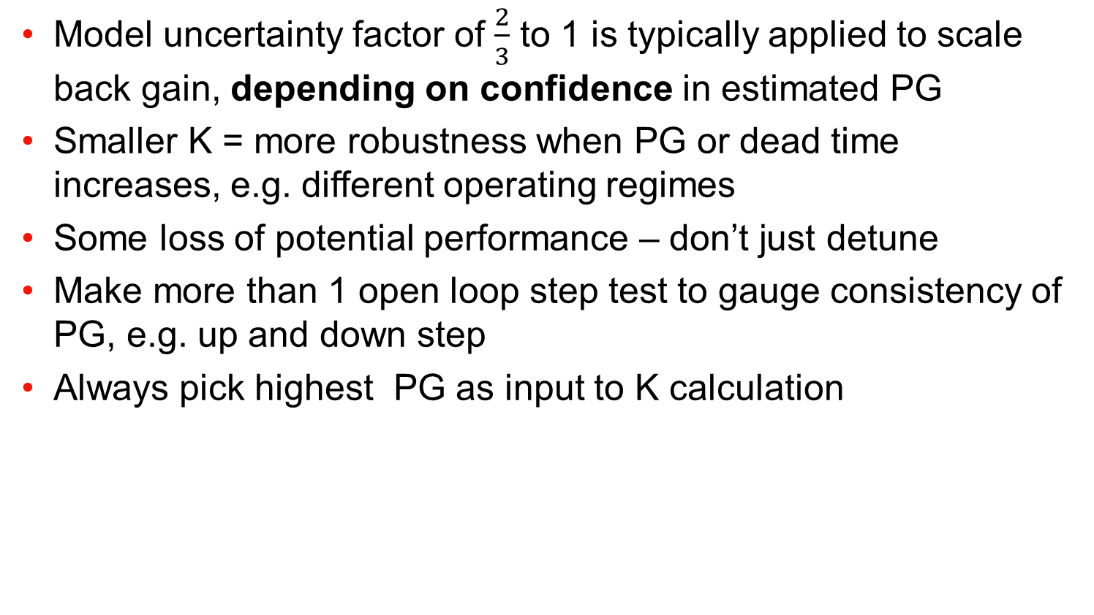
Proportional Action: How to calculate K (2)
27

Slide 28
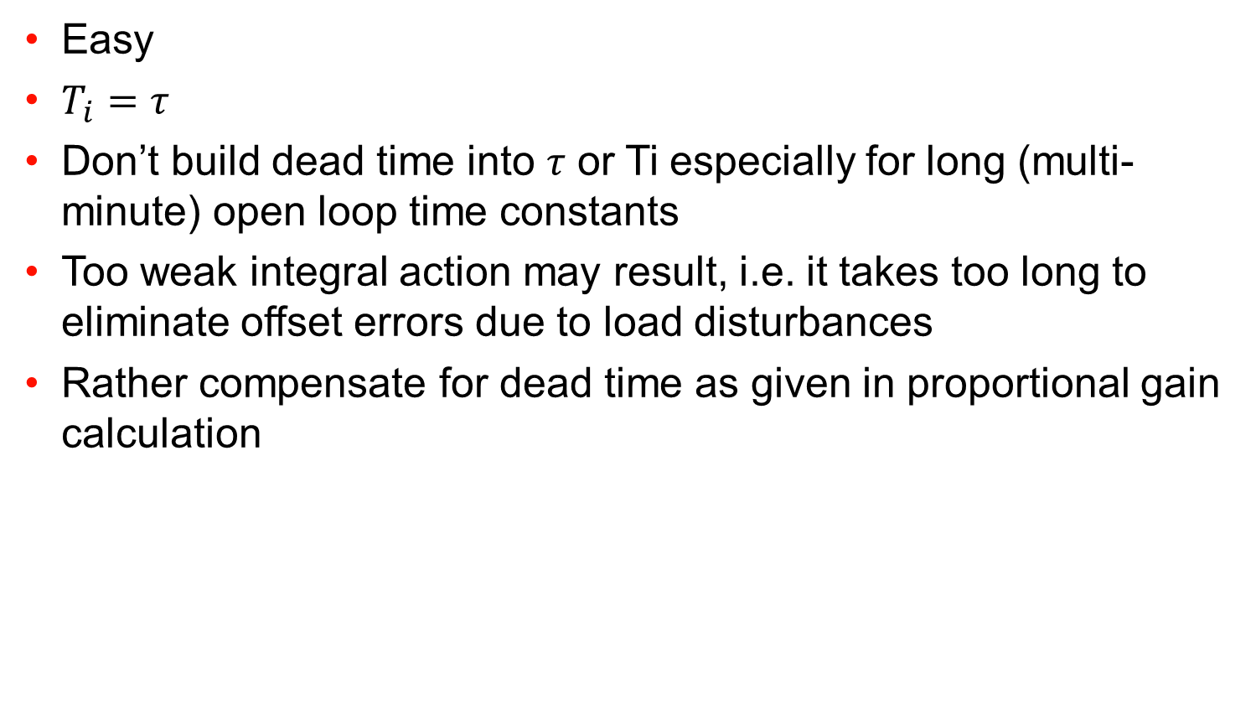
Integral Action: How to calculate Ti
28

Slide 29
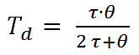
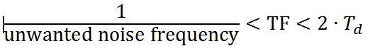
Derivative Action: How to calculate Td and TF
Theoretically, Td only helps with S-shaped (2nd order / higher) open loop responses, therefore primarily temperature and composition, not flow and pressure
Expect ~20% improvement from a base of good PI, not a “miracle cure” for bad PI
Practically, this means 0.33 to 0.5 θ in most cases (θ ≤ τ)
TF is very important to filter a noisy PV otherwise noise is transferred to actuator movement
Rule of thumb:
29

Slide 30
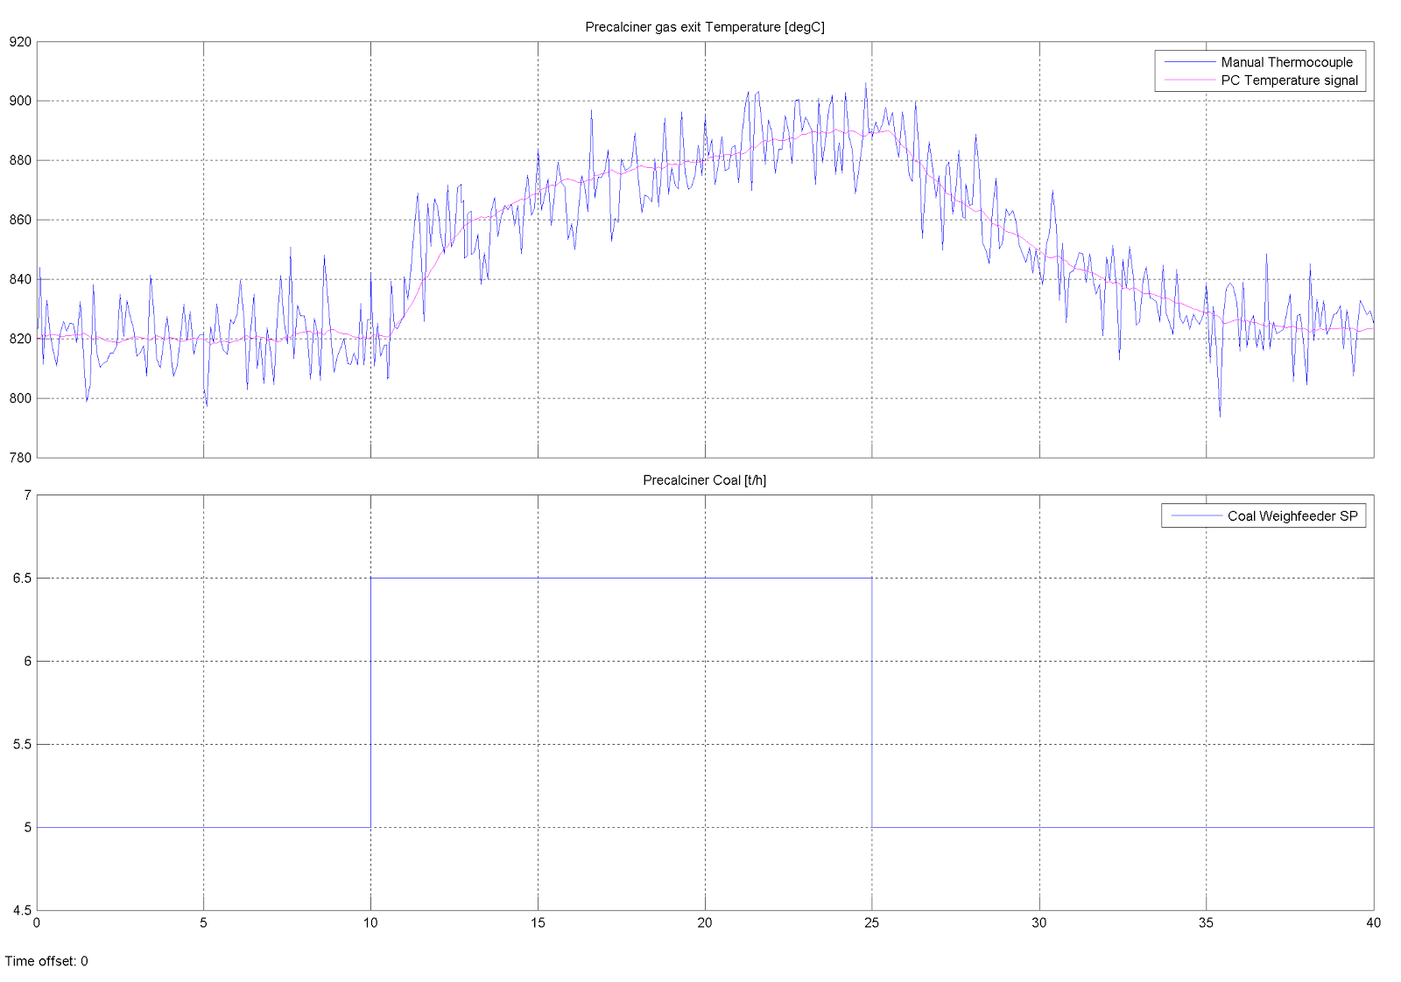
A calculation example
SS
0.632
τ
θ
30

Slide 31
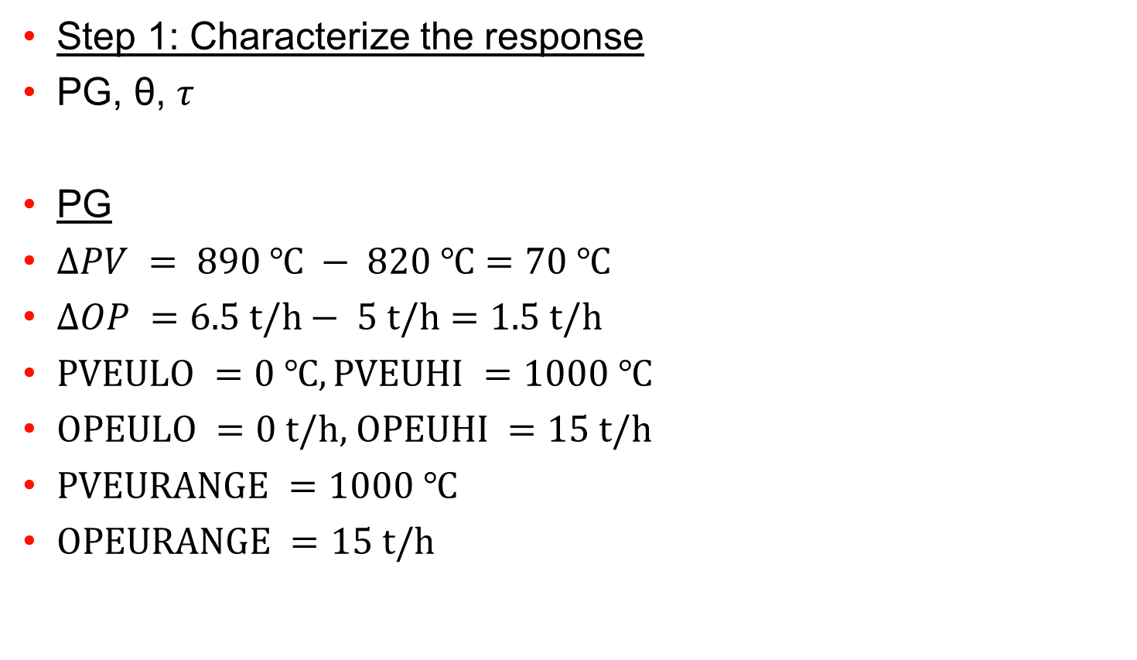
A calculation example
31

Slide 32
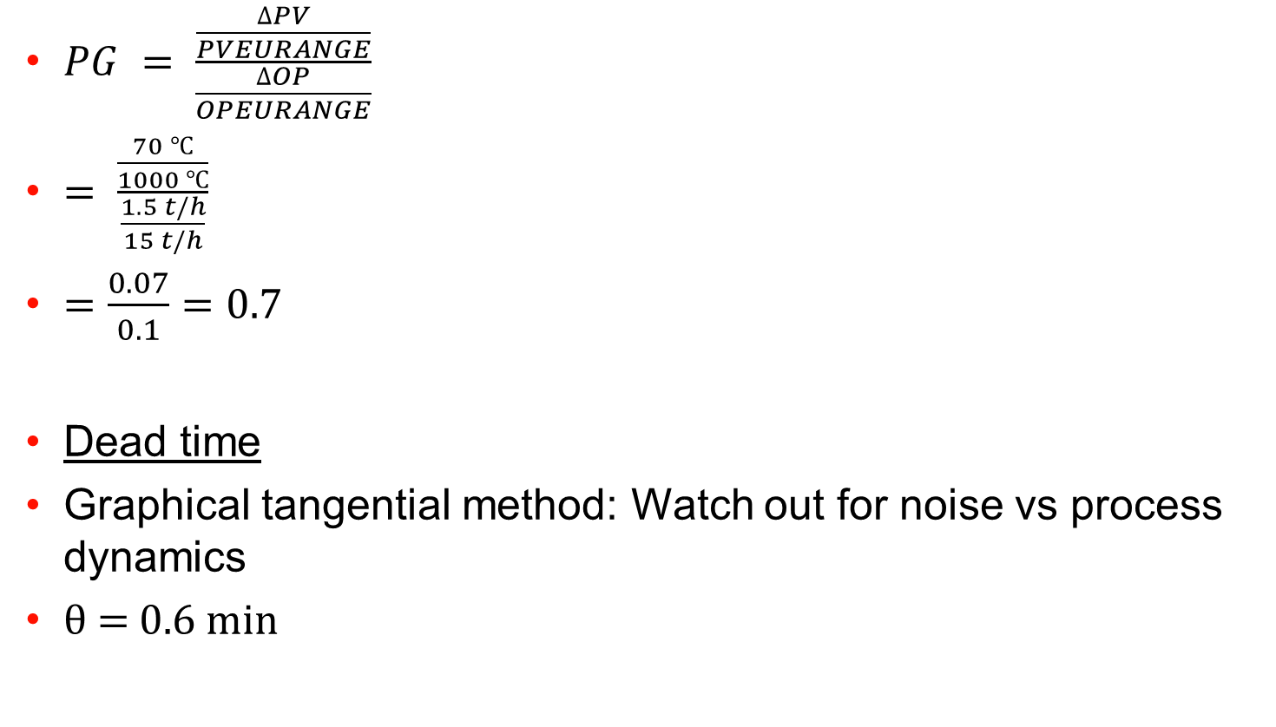
A calculation example (2)
32

Slide 33
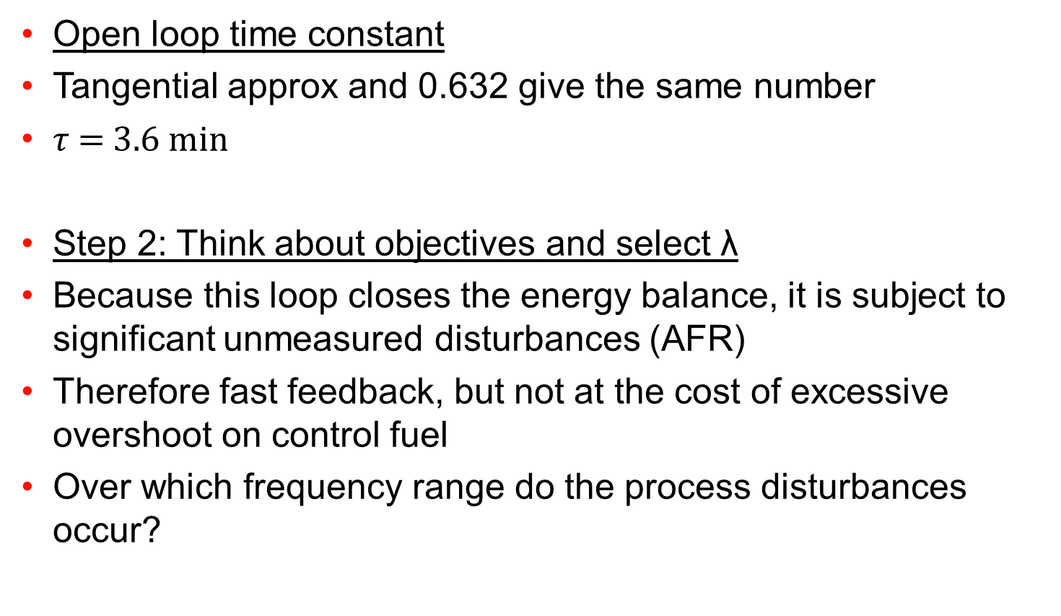
A calculation example (3)
33

Slide 34
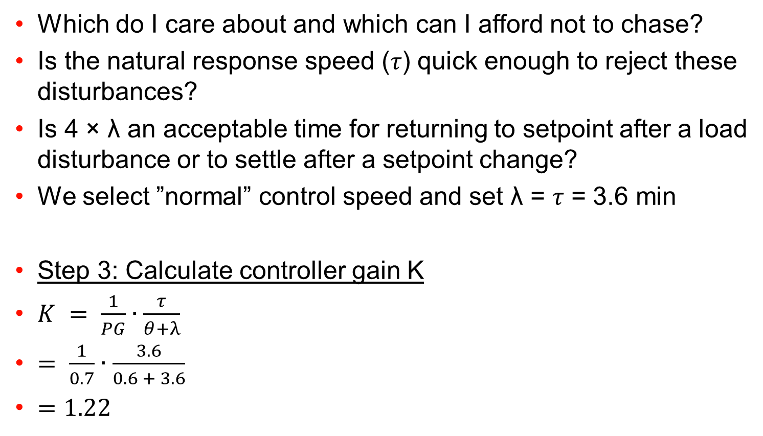
A calculation example (4)
34

Slide 35
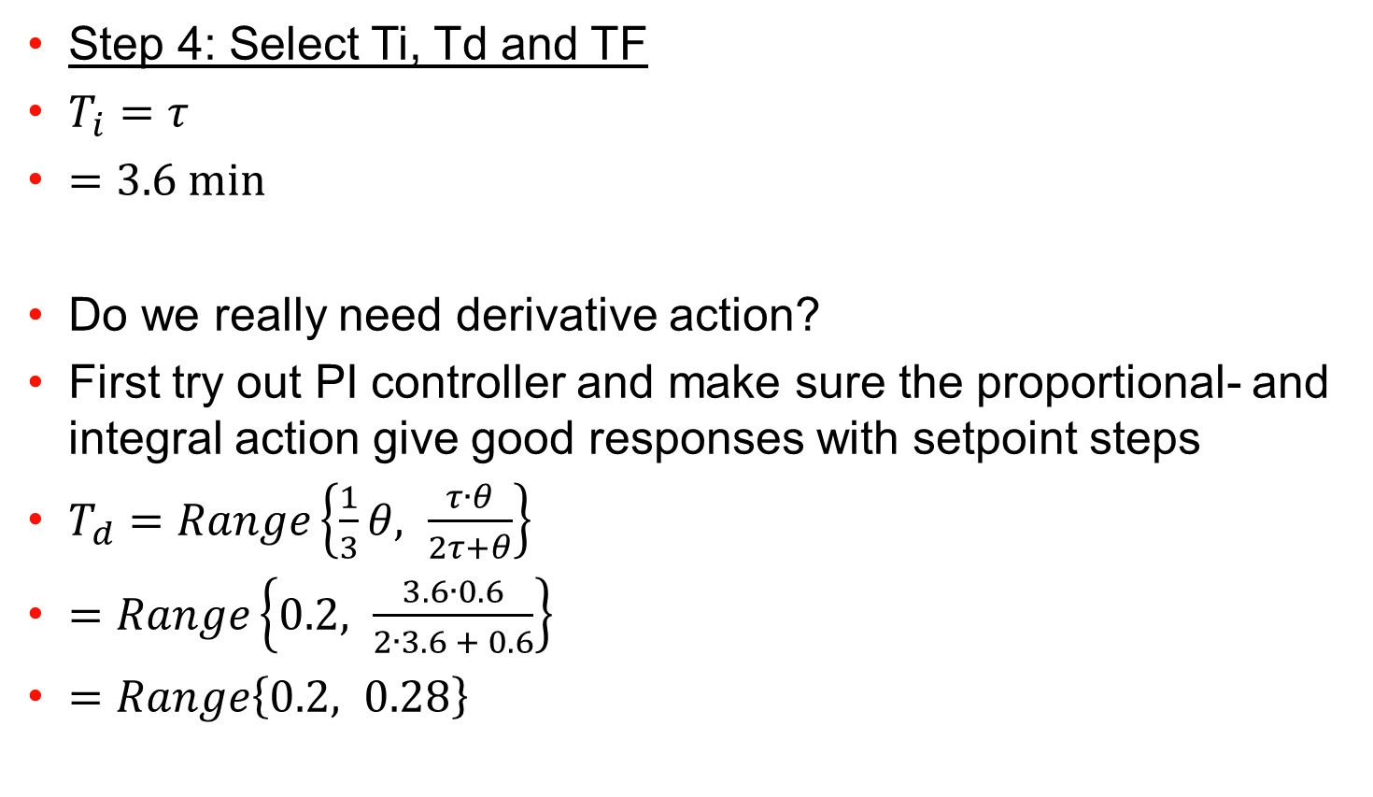
A calculation example (5)
35

Slide 36
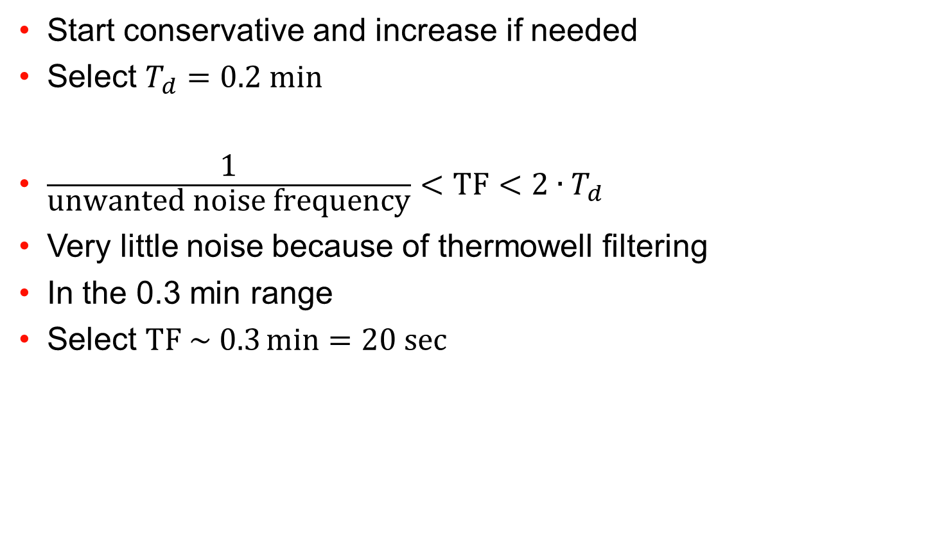
A calculation example (6)
36

Slide 37
37

Slide 38
3 Actions to decrease kJ/kg cli Kiln operation actions that you can implement now
Increase cooler recuperation efficiency
Increase SAT/TAT
Cooler control
Decrease preheater losses
Decrease preheater exit O2
Gas flow control
Decrease preheater losses
Decrease preheater exit temperature
precalciner temperature control
38

Slide 39
Cooler Control
Step 1: Stabilize SAT/TAT
Step 2: Increase SAT/TAT
Step 3: Reduce fuel rate
→ Lower Heat consumption
39

Slide 40
Cooler Control Step 1: Stabilize SAT/TAT – Clinker bed height
SAT/TAT are a function of clinker temperature - cannot control
SAT/TAT are a function of air residence time through clinker
clinker bed height
air speed in recuperation zone
For stable short-term SAT/TAT (0-60 minutes):
Stabilize clinker bed height
Stabilize air speed in recuperation zone
Longer term stability of SAT/TAT is separate issue
40

Slide 41
Cooler Control Step 1: Stabilize SAT / TAT – UnderGrate Pressure Control
UGP usually has excellent short-term relationship to SAT/TAT
Increase UGP → increase SAT/TAT and vice-versa
Defining UGP
Select earliest UGP measurement in cooler which is reliable
Reason: improved control loop dynamics
Usually, but not always, this means fixed inlet UGP
UGP is controlled at its setpoint (mbar) by moving grate speed (spm) through the use of an automatic control loop (PID)
41

Slide 42
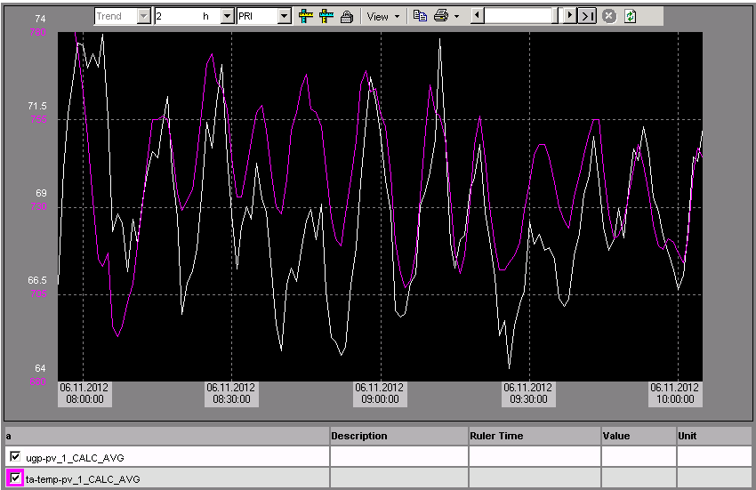
Cooler Control Step 1: Stabilize SAT/TAT – UnderGrate Pressure Control
42

Slide 43
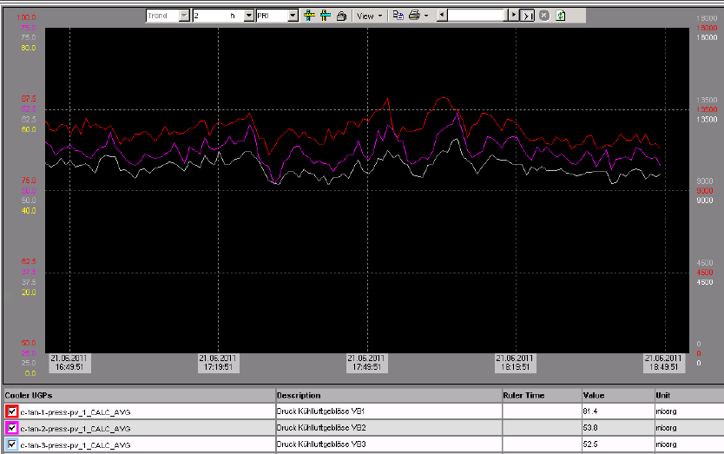
Cooler Control Step 1: Stabilize SAT/TAT – Early UGP measurement
Secret to good UGP control: “early” UGP measurement
43

Slide 44
Cooler Control Step 1: Stabilize SAT/TAT – Stable fan flow or SP change!
Fundamental requirement for UGP control is constant air flow in the compartment where UGP is measured
Linear relationship between UGP and fan air flow:
Options:
Keep air flow under UGP constant (typical if fixed inlet used), or
Adjust UGP setpoint in fan table according to flow relationship
44

Slide 45
Cooler Control Step 1: Stabilize SAT/TAT – Stable fan flow or SP change!
Example: Fan table, if UGP is in compartment 2
Example: Tests show that +2,000 Am3/h = +2 mbar UGP
Feed t/h | UGP SP mbar | Fan 1 Am3/h | Fan 2 Am3/h | Fan 3 Am3/h | Fan 4 Am3/h | Fan 5 Am3/h | Fan 6 Am3/h
200 | 70 | 35,000 | 20,000 | 20,000 | 22,000 | ... | ...
220 | 72 | 35,000 | 22,000 | 22,000 | 24,000 | ... | ...
240 | 74 | 35,000 | 24,000 | 24,000 | etc... | ... | ...
260 | 76 | 35,000 | 26,000 | 26,000 | ... | ... | ...
280 | 78 | 35,000 | 28,000 | 28,000 | ... | ... | ...
45

Slide 46
Cooler Control Step 1: Stabilize SAT/TAT – Grate Speed PID Tuning
If new to PID tuning, apply following steps
Guide values (starting point)
Kp = 1.0
Ti = 480s
Td = 0s
Decrease UGP setpoint of existing PCS PID by 3 mbar
Observe UGP response in PCS. Good result is:
UGP reaches new setpoint within 10 minutes
Overshoot of max 1-2 mbar
Repeat test in other direction
If taking too long to reach setpoint, decrease Ti and vice-versa
Stability benchmark: stdev of UGP at constant SP: <2 mbar*
Stdev UGP 2 mbar = ~ stdev SAT 20°C*, stdev TAT 25°C
*= minutely spot data from TIS, typical thermocouple
46

Slide 47
Cooler Control Step 2: Increase SAT/TAT – Simple Steps
Now that short-term UGP has been stabilized, we can operate more safely with higher clinker bed (= higher SAT/TAT)
Simply increase the UGP setpoint +3 mbar
Observe results over 24 hours
Did SAT/TAT clearly increase sustainably over 24 hrs.?
If yes (most common starting case), repeat test, setpoint +3 mbar
Did SAT/TAT do nothing?
If yes, return UGP to setpoint
Maybe try decreasing UGP setpoint -3 mbar, observe over 24 hrs.
----------------------------------------------------------------------------------
Did SAT/TAT decrease?
If yes, decrease UGP setpoint -3 mbar, observe over 24 hrs.
47

Slide 48
Cooler Control Step 3: Decrease Fuel to main burner and precalciner
If TAT has increased, and precalciner temperature is controlled by PID, then the fuel rate to precalciner will decrease automatically
If SAT has increased:
Operator needs to reduce fuel manually (no BZT PID)
Should occur “automatically” because free lime will decrease
May not occur if operator continues to use his “normal” fuel rate to main burner
48

Slide 49
49

Slide 50
Gas Flow Control
Step 1: Gas flow stabilization
Step 2: Oxygen stabilization
Step 3: Reduce oxygen content
Step 4: Reduce fuel feedrate
→ Lower Heat consumption
50

Slide 51
Step 1: Gas flow Stabilization
Oxygen vs. gasflow
What is the difference?
Influences on O2 content:
NCV
Fuel feeding
Kiln feeding
What should we be controlling?
Concept:
Stable material to gas relationship
Stable velocities in PH tower & kiln
51

Slide 52
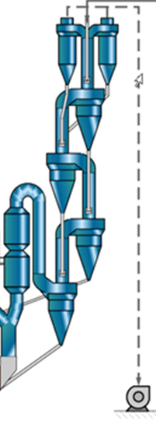
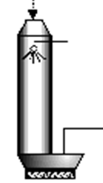

Step 1: Gas flow Stabilization
Two cases
Coal mill
No disturbance before ID fan
Disturbance(s) before ID fan
52

Slide 53
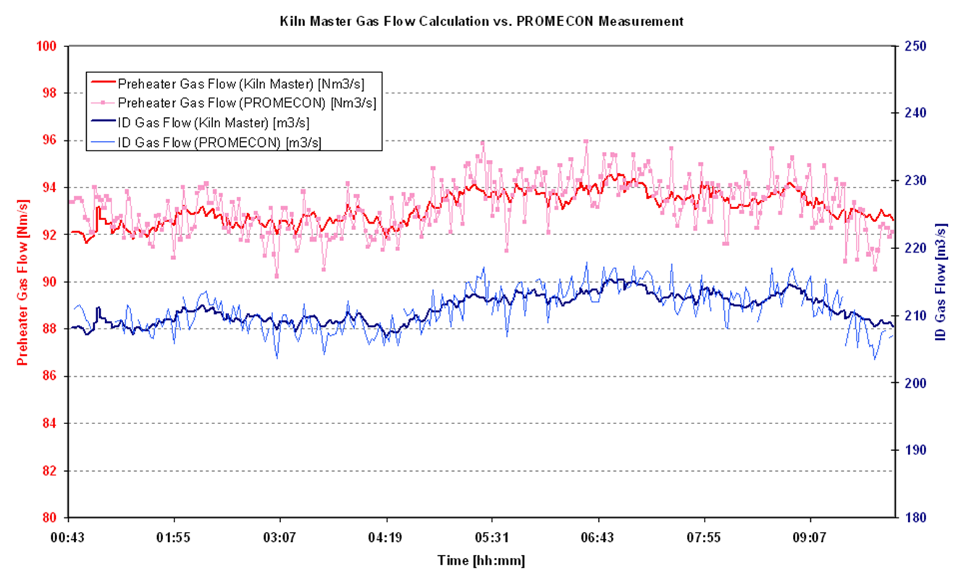
Step 1: Measurement of gas flow
Direct measurement
Promecon (ca 20 kUSD)
Calculation
kWFanmotor·η
Flow=
ΔpFan
53

Slide 54
Step 1: Manual “control” of gas flow
Calculation
Fan flow:
Maintain flow constant (short term)
Maintain ID fan speed
Maintain dp across fan
Stable outlet pressure → Filter fan loop
Stabilize water control loop → minimize influence → tune PID
Coal mill start stop procedure → minimize influence with SOP
Raw mill start/ stop procedure → minimize influence with SOP
Maintain pressure at PH outlet constant with ID fan speed
Implemented in some plants (usually in 2 fan systems)
Frequent adjustment of pressure SP required
kWFanmotor·η
Flow=
ΔpFan
54

Slide 55
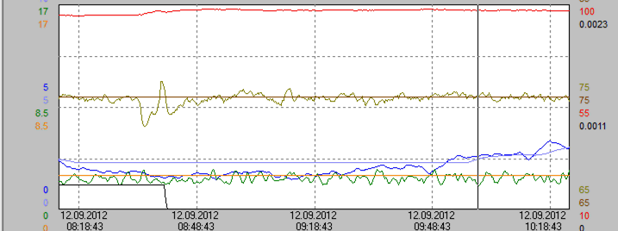
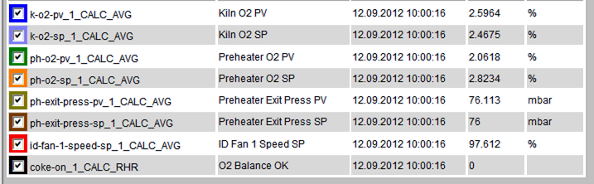
Step 1: minimize influences of coal mill stops
55

Slide 56
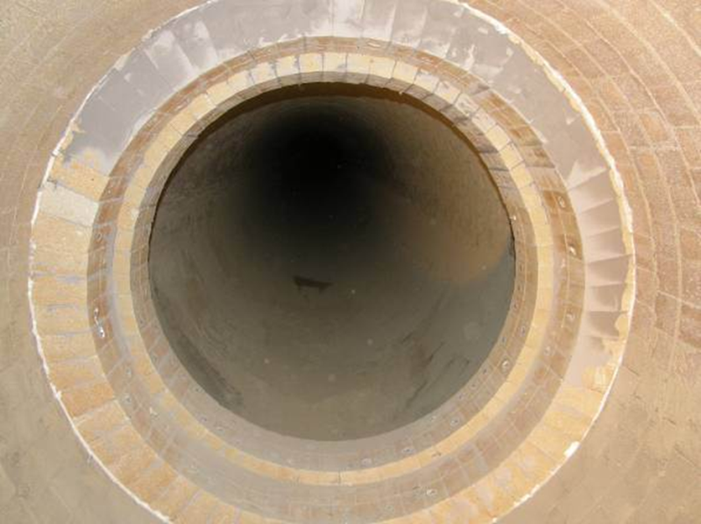
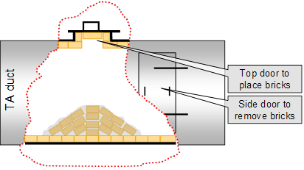
Step 1: Control of Gasflow at kiln inlet
Measurement: Kiln inlet probe
Control:
Tertiary air damper: Strategy to minimize wear:
Normally almost completely open
Adjustment of dp with additional resistances in TAD
56

Slide 57
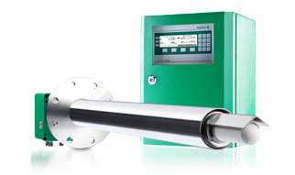
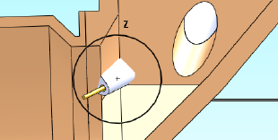
Step 2: measurement of oxygen
Preheater exit
As replacement of PC exit
Less maintenance in this location
Insitu (e.g.ENOTEC) or extractive measurement
Sinter metal probe
Double probe to avoid cleaning spikes
Kiln inlet
Recommended suppliers:
FLS Airloq, ENOTEC, SICK, ABB
Placement critical: Protect probe from falling coating
Difficult measurement but with right probe and right location continuous measurement possible
57

Slide 58
Step 2: Stabilize O2
Stable gas flow
Stable energy inputs
Cooler control to stabilize recuperation
precalciner control to stabilize energy input
AFR (energy) compensation
Proper PID tuning of loop
Control of Kiln inlet oxygen
Working tertiary air damper and kiln inlet probe
Maintaining kiln inlet oxygen level should not require excessive oxygen level at preheater exit
58

Slide 59
Step 3: Reduce Oxygen content
Step 3: Reduce O2 content
Minimum required to avoid excessive CO formation
Any reserve is additional heat consumption
Check
Preheater velocities if running at low production rates
Orifice velocity to ensure proper meal pick up
Typically 0.5 – 1% at PC exit ( lowest stage cyclone are sufficient)
Step 4: Reduce fuel feedrate
→ Lower Heat consumption
59

Slide 60
Step 4: Reduce fuel feedrate
With lower gasflow and better heat recuperation in cooler fuel feedrate at precalciner/preheater can be lowered.
No heat consumption reduction if this is not been done
60

Slide 61
61

Slide 62
Precalciner Temperature (PCT) Control
Step 1: Stabilize PCT
Step 2: Decrease PCT → Decrease preheater losses
Step 3: Reduce fuel rate
→ Lower Heat consumption
62

Slide 63
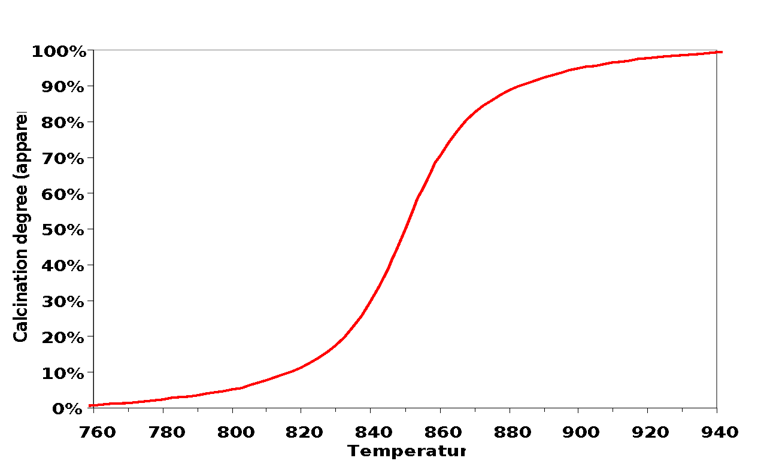
Precalciner Temperature Control Step 1: Stabilize PCT
PCT usually means bottom cyclone exit temperature
PCT is related to calcination degree by the “calcination curve”
Note: Calcination reaction itself is fast at <95% (1-3s)
63

Slide 64
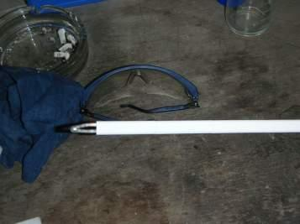




Precalciner Temperature Control Step 1: Stabilize PCT – Fast Thermocouple Measurement
Key #1 to good PCT control:
Fast temperature measurement (or at least, not slow)
Main issue is thermowell thickness, sometimes thermocouple
Measurement is only at the junction
64

Slide 65





Precalciner Temperature Control Step 1: Stabilize PCT – Fast Thermocouple Measurement
65

Slide 66
Precalciner Temperature Control Step 1: Stabilize PCT – PCT PID Tuning
Key #2 to good PCT control: Well tuned PID controller!
Guide values (starting point)
Kp = 0.2
Ti = 200s
Td = 0s
Increase PCT setpoint +10°C
Observe PCT response in PCS. Good result is:
PCT reaches new setpoint after ~15 minutes
Little or no overshoot
Repeat test in other direction
66

Slide 67
Precalciner Temperature Control Step 1: Stabilize PCT – PCT PID Tuning
Stability benchmark depends on PCT setpoint and AFR%
All values are standard deviations of control error (PV-SP)
 | 0% AFR | 50%AFR | 100%AFR
870°C SP | 2°C | 5°C | 8°C
920°C SP | 3°C | 7.5°C | 12°C
67

Slide 68
Precalciner Temperature Control Step 2: Reduce precalciner Exit Temperature (PCT)
Stable PCT → Reduce PCT setpoint → Lower PH exit temp. → Lower heat losses → Lower STEC
The precalciner was invented in order to separate the calcination and the sintering processes
More efficient heat transfer of gas with powder
Not necessary to combust the fuel for calcination in the sintering zone
Not necessary to transport the combustion gases and CO2 from raw meal calcination through the kiln
Allows higher kiln capacities for the same rotary kiln diameter
In principle therefore, we want the material leaving the precalciner to have a very high calcination degree → high temperature
BUT, high temperature = higher preheater exit temperature
68

Slide 69
Precalciner Temperature Control Step 2: Reduce precalciner Exit Temperature (PCT)
This temperature scale varies between plants and so this graph cannot directly be applied to your precalciner
Δ T°C
Δ Calcination
Easier to control calcination using temperature
Δ T°C
Δ Calcination
Difficult to control calcination using temperature
69

Slide 70
Precalciner Temperature Control Step 2: Reduce precalciner Exit Temperature (PCT)
This temperature scale varies between plants and so this graph cannot directly be applied to your precalciner
Δ T°C
Δ Calcination
Easier to overheat, cause build-ups, waste fuel
Δ T°C
Δ Calcination
No problems
70

Slide 71
Precalciner Temperature Control Step 3: Reduce Fuel Rate
Because we are using a PID, the fuel rate will decrease automatically!
71

Slide 72
72

Slide 73
Summary
Get out of your office to the CCR!
A setpoint used for 20 years does not mean that it is the optimum!
Check and optimize
Increase cooler recuperation (UGP)
Lower precalciner temperature (PCT)
Minimize and stabilize gas flow (PH O2)
PID loop well tuned utilized by the operators. If not in use: Tuning required!
Minimize kiln stops with maintenance
73

